Slide 1
Health Analysis
The effects of Unhealthy Behaviors
to Mental Health Conditions
Sandrine Poissonnet Project USC Data Science Bootcamp
Nicole Young January 28th, 2019
Maaike Rutten

Slide 2
The Dataset
Data provided by the Centers for Disease Control and Prevention (CDC)
Includes measures of chronic disease related to unhealthy behaviors, health outcomes and use of preventive services
500 largest cities in the US
Data of 28 million individuals bundled in groups of 1000
Years 2015 & 2016

Slide 3
Strengths & Limitations of the Dataset
+ Very large amount of interesting data
+ Detailed information
- Too much information to research all factors,
- Choices need to be made for reducing the number of factors
- Small US cities are not taken into account
- Complex formulation & subject

Slide 4
Methods & Choices
Added an API to show deviation over the US
Focus on Mental health conditions & unhealthy behavior
Grouping, Research correlations, AVOVA testing, T-testing, use of API
Small peek into other factors: lack of health insurance, income, education, age & gender

Slide 5
Hypothesis
Is the prevalence of poor mental health equally divided over the US or does this occur more in certain states? What are observed reasons for this?
What types of unhealthy behavior have significant effects on the mental health and to what extent?
What other factors, which included in this study that influence mental health?

Slide 6
Summary of findings
Poor mental health seem to occur more in large cities in the states Texas, North Dakota and Nebraska. This are also the state with higher percentages of Binge-drinkers, MAKE CHOROPLETH SLEEP/LPA/SMOKE/OBESE
Smoking and a lack of Sleep have the greatest impact on mental health. Bring-drinking, Obesity and lack of physical activity have, but to a lower extent significant effects as well.
Other factors that have a significant impact on mental health are education, and income. Gender and age do not have a significant impact.
The lack of health insurance has a correlation with poor mental health.

Slide 7
Data exploration & cleanup process
Step 1: Reduce the size of the dataset: Focus only on:
5 unhealthy behaviors:
smoking,
binge-drinking,
lack of physical activity,
obesity,
lack of sleep
Health-outcome: Mental Health
Location: State, City
Demographics*: income, education, gender, age
Preventive Service* : lack of health insurance

Slide 8
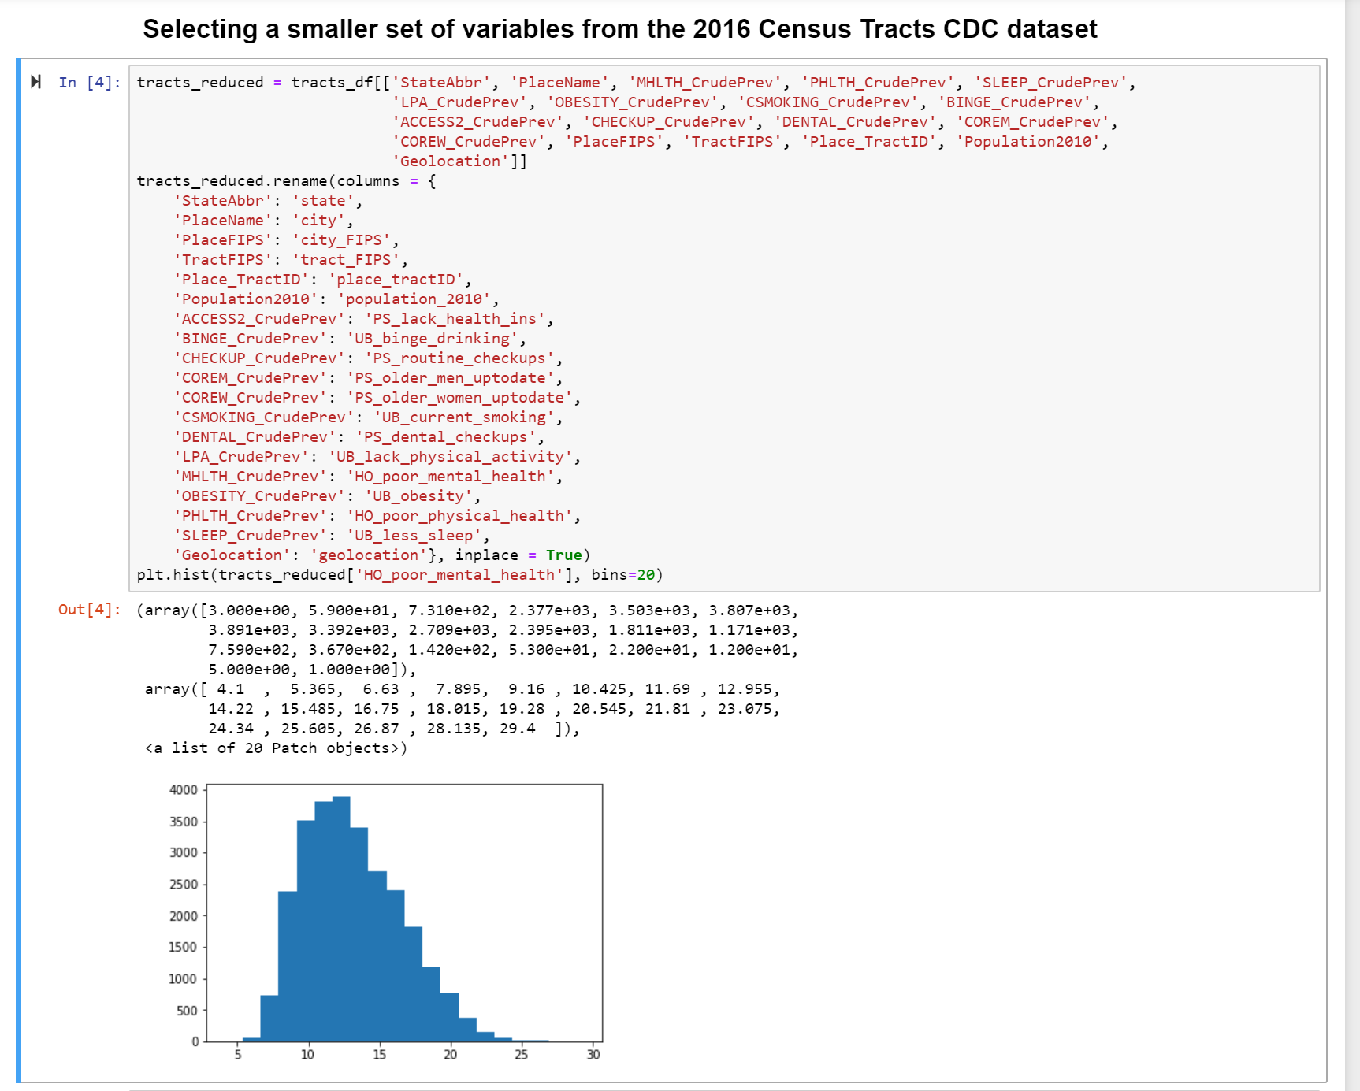
Data exploration & cleanup process

Slide 9
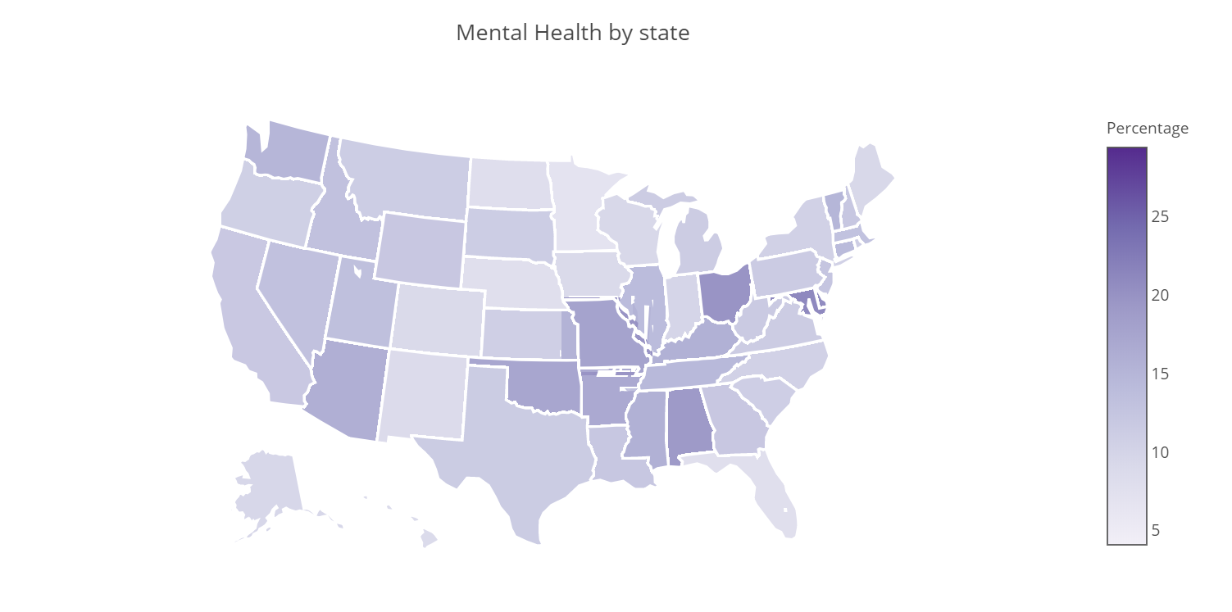
Question 1: Is the prevalence of poor mental health equally divided over the US or does this occur more in certain states? What are observed reasons for this?
Update choropleth + add cities
Show Jupyter notebook
Add text conclusion

Slide 10
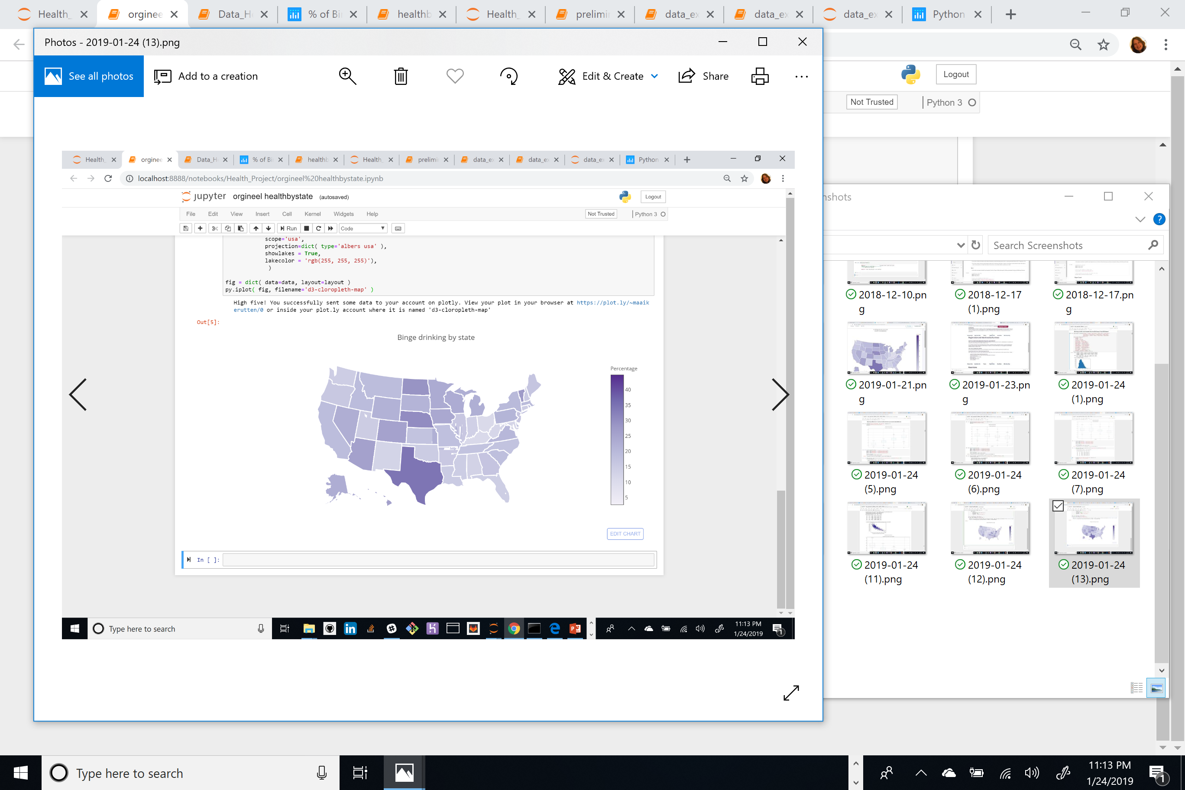
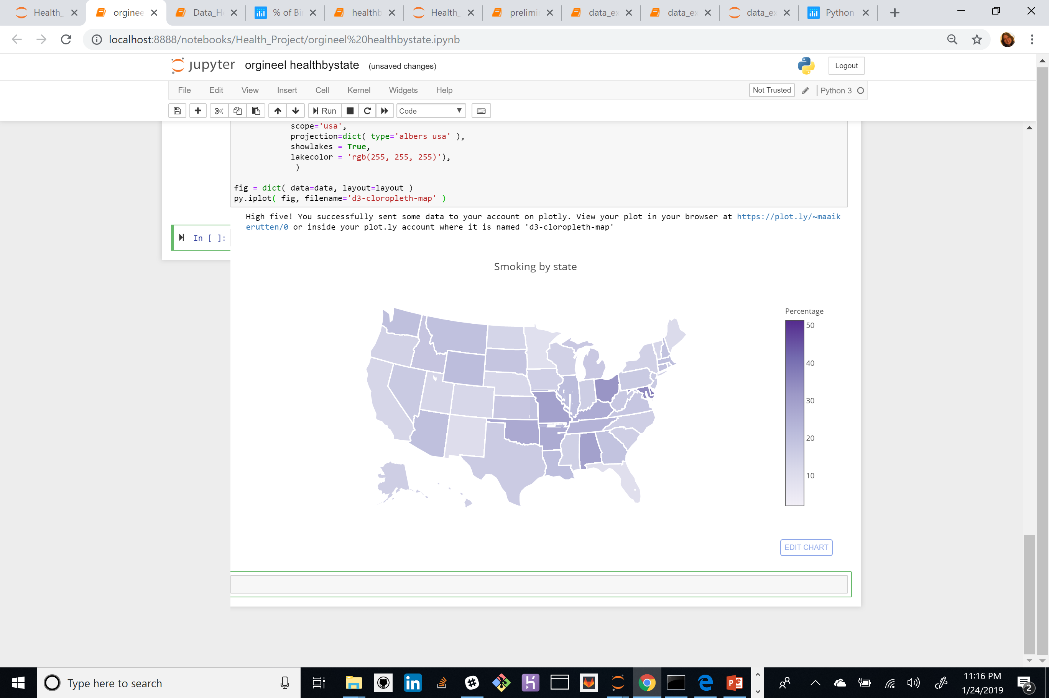
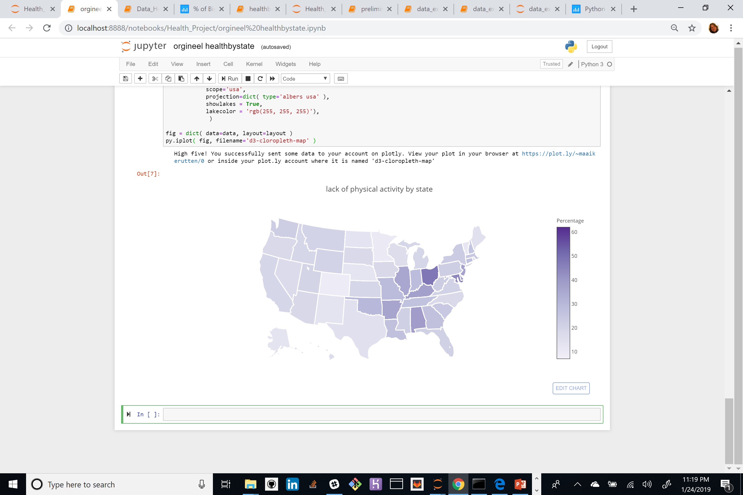
Unhealthy behaviors choropleths, text

Slide 11
Question 1 conclusions.
Conclusion per state?? Not sure if that’s possible, outcomes are so different… maybe we can do some extra statistical testing on this. Or we can conclude that: the differences per state are not so easy to discover . But there are some interesting findings (binge drinking in Texas, smoking lack of activity in Ohio).

Slide 12
Question 2: What types of unhealthy behavior have significant effects on the mental health and to what extent?
Binning into 4 groups by mental health scores.
The cities with the 25% highest score of persons with a poor mental health (meaning: high score is not desirable), next 25%, next 25%, last group: with lowest score (least people with poor mental health).
Create boxplots and do statistical tests to check on various indicators by mental health:
Correlation with poor physical health
Correlation with unhealthy behaviors:
Binge-drinking
Lack of sleep
Smoking
Lack of physical activity
Obesity

Slide 13
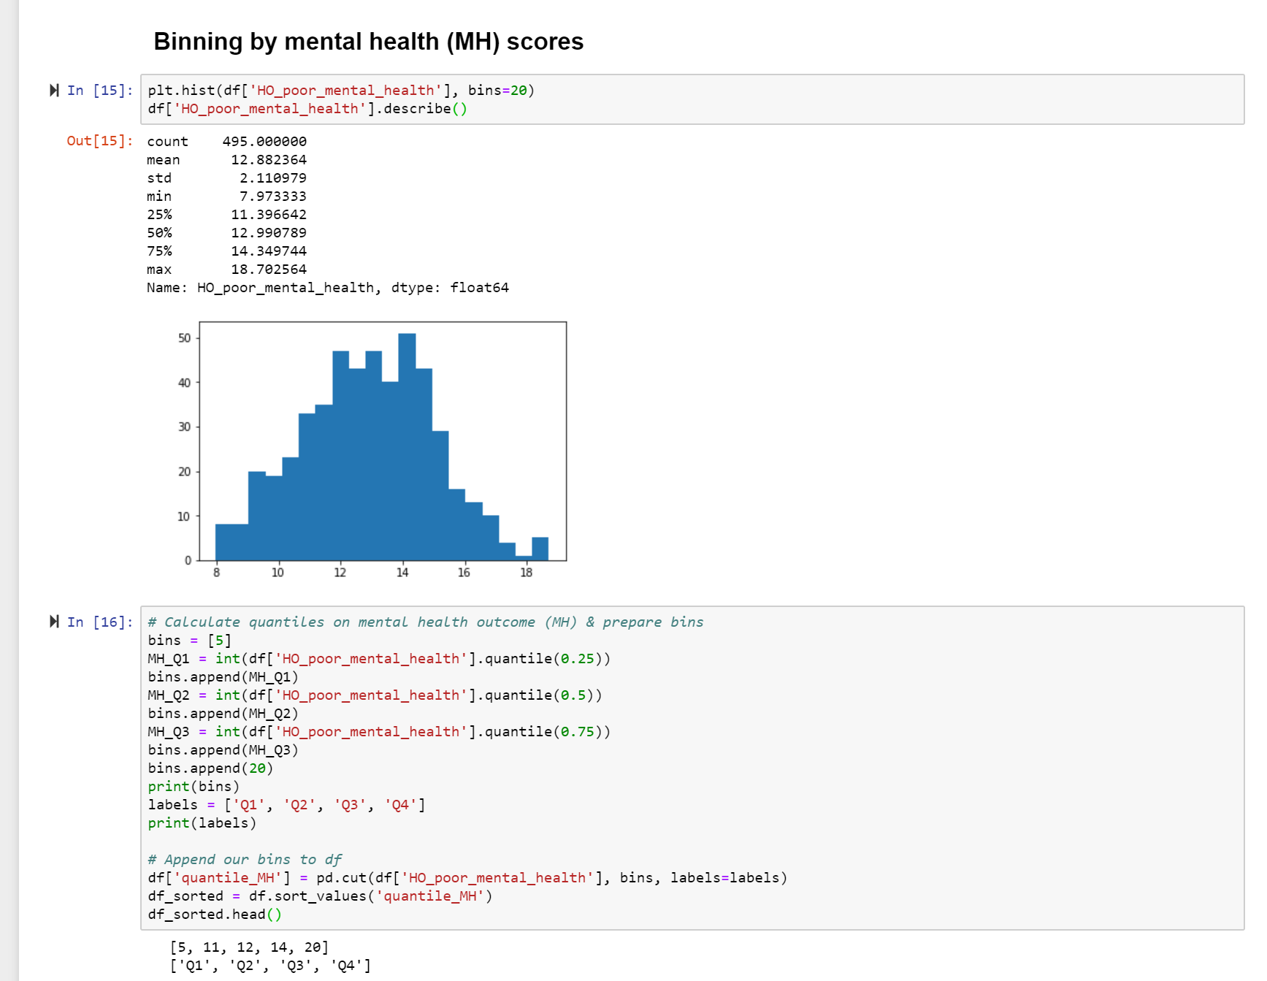
Question 1: What types of unhealthy behavior have significant effects on the mental health and to what extent?

Slide 14
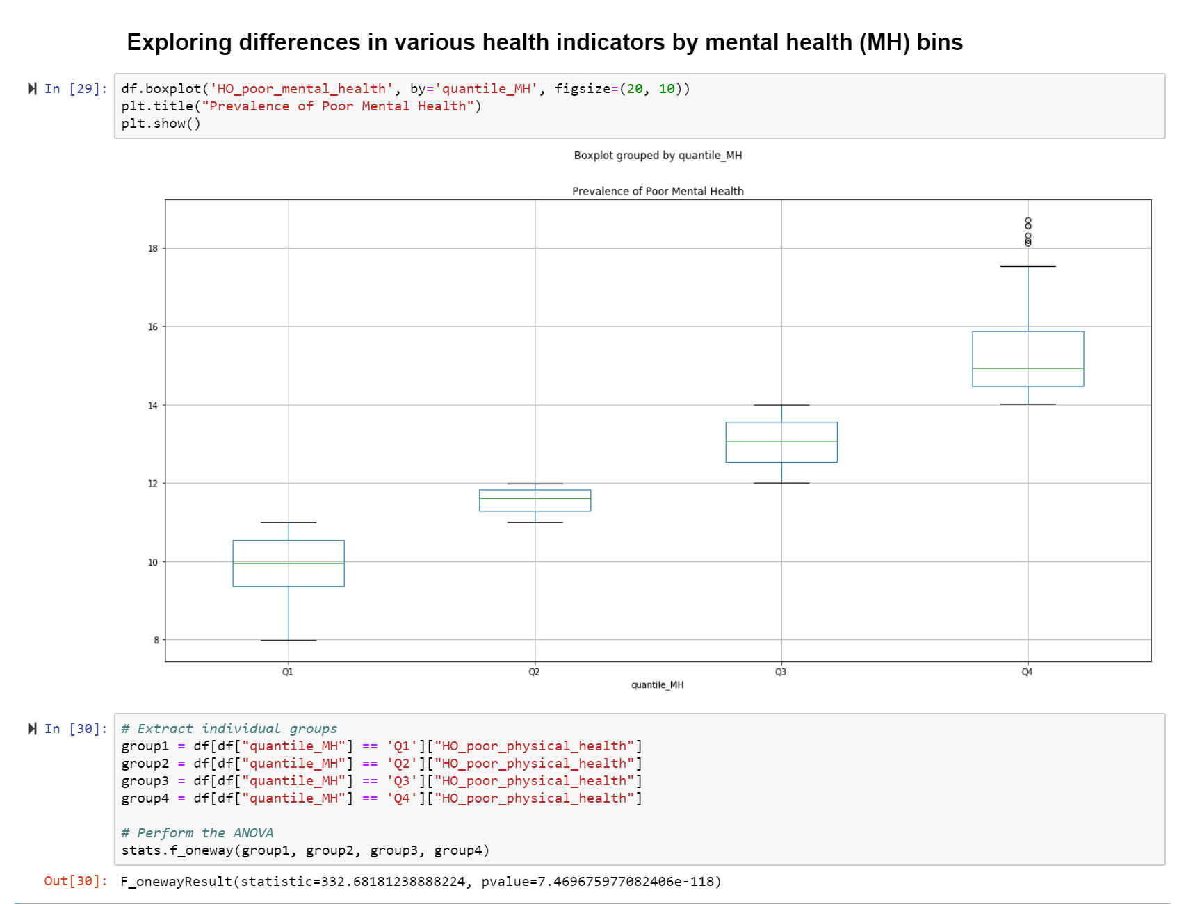
Correlation Mental health & Physical health

Slide 15
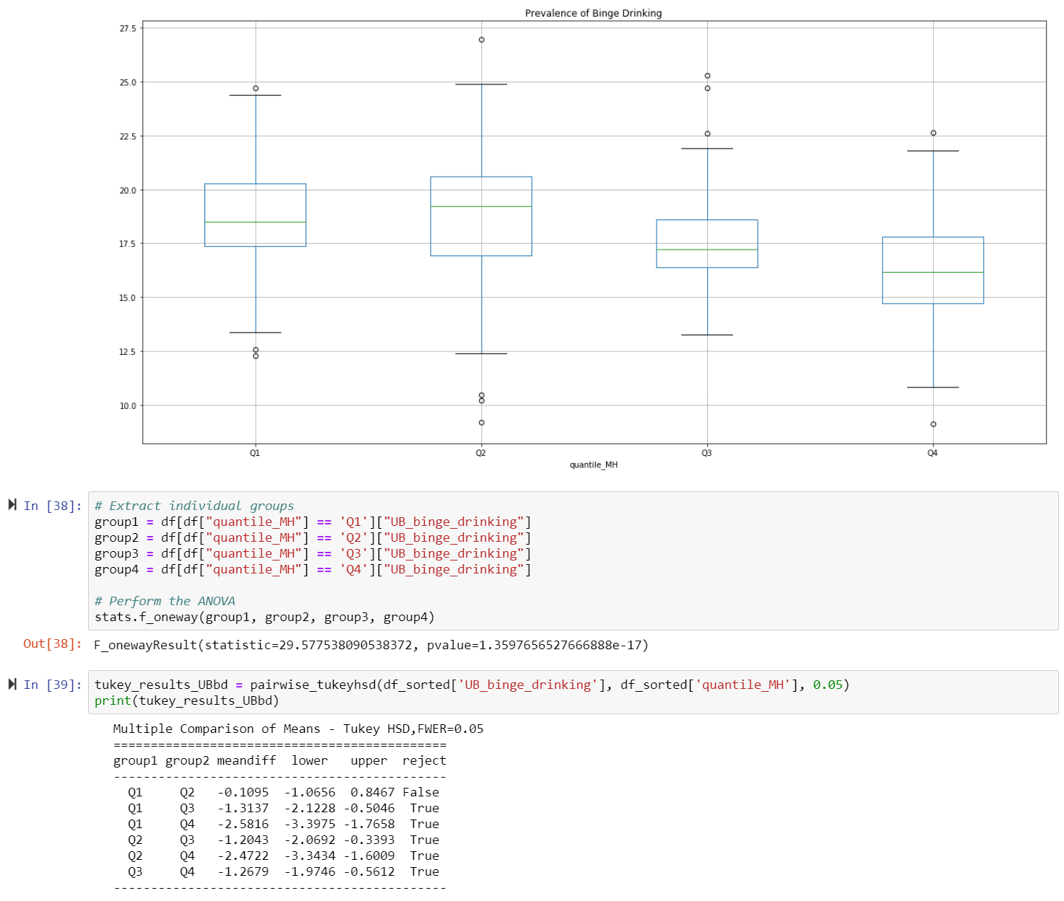
Correlation mental health & Binge-drinking

Slide 16
Correlation mental health & Smoking
Add Box plot (exists, only fine tuning)
Add text conclusion

Slide 17
Correlation mental health & lack of sleep
Add Box plot (exists, only fine tuning)
Add text conclusion

Slide 18
Correlation mental health & obesity
Add Box plot (exists, only fine tuning)
Add text conclusion

Slide 19
Correlation mental health & lack of physical activity
Add Box plot (exists, only fine tuning)
Add text conclusion

Slide 20
Conclusion correlation Mental health & unhealthy behavior
Add chart with all unhealthy behaviors combined (we still have to make this chart).
Conclusion summary all unhealthy behaviors

Slide 21
Question 3: What correlation can be found between Mental health & income, education, lack of health insurance

Slide 22
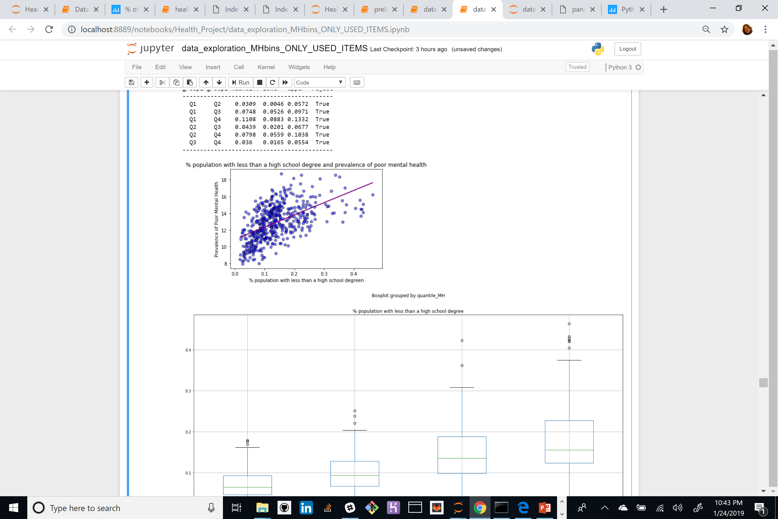
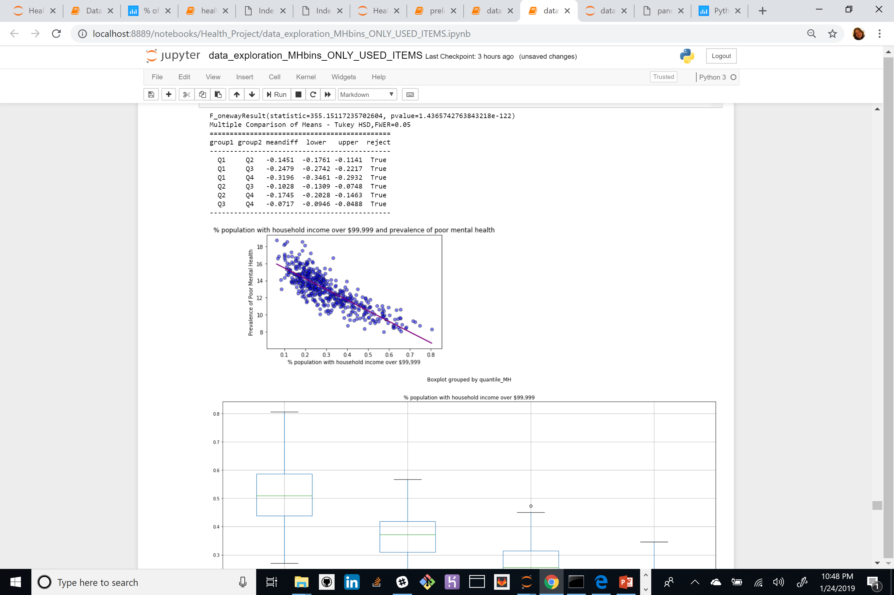
Correlation mental health & Education or Income
Education: the higher the proportion of persons with only a high school degree or less in the population, the higher the prevalence of poor mental health and the higher the proportion of persons with a bachelor degree of higher, the lower the prevalence of poor mental health.
Income: the higher the proportion of persons with a household income under $25,000 in the population, the higher the prevalence of poor mental health and the higher the proportion of persons with a household income over $99,999 , the lower the prevalence of poor mental health.

Slide 23
Correlation mental health & lack of health insurance
scatterplot with bubbels that shows lack of health insurance (Sandrine showed it, looked perfect, but I can’t find it anymore)
Text conclusion health insurance

Slide 24
Major Findings & Additional Research
Some states have higher rates of persons with a poor mental health than others: a deeper dive into this states specifically could give interesting information on the specific reasons for this high rates and discover if these differ from states with low rates of poor mental health or if it’s related to other factors.
Poor mental health correlates with all the researched unhealthy behaviors, research could be done if other health outcomes (f.e. poor physical health ) have the same correlations
Income and education correlate with the prevalence of poor mental health: the higher the income or education, the lower the % of persons with a poor mental health. Interesting would be to further research where the conversion point lays
The lack of health insurance correlates with poor mental health. Researching how politics could influence this (Obama care?) . Or the correlation between income and lack of health insurance.

